Slide 2
Real Estate Management & rentUp System
Submitted to:
Department of Computer Science & Information technology

Slide 3
Team members 1.Aditya Polekar(0827CI191003) 2.Aayush Mishra(0827CI191002) 3.Utkarsh Shrivastava(0827CI191061)
Real-estate management and rent up system

Slide 4
Project Presentation Outline
Abstract
Introduction
Problem Statement
Survey of Existing Systems
Project Objectives
Requirement Analysis
Solution Proposed
The Outcome Discussion
Conclusions and Limitations

Slide 5
Abstract
This system will provide facility to the user to search Residential and Commercial property and view property. This system will provide facility to view the property by admin and user. The user will be able to upload the property information to the site and be able to manage it. This system will provide facility to the user to fill up their requirement and according to their Requirement Admin can add the Requirement property. This system will provide facility to the user to publish advertisements to the Site and view.

Slide 6
Introduction
This website is made to automate the user will not able to go anywhere they can directly Communicate with the system they can mention their selling property in our website so that user will able to see their property with their budget and if this will suited to the user. They can directly contact with seller for negotiating price of property.
Our website will all the buyers and sellers so they can easily and effortlessly buy and sell properties without any trouble.
Motivation behind taking was to ease up the problems faced by many people who wish to buy and sell properties but due to current system of buying and selling properties are not able to do it effortlessly.

Slide 7
The Problem Statement
Property management system for this organization uses traditional method of keeping records of the client’s files. This manual record keeping in the organization has been characterized by a lot of problems, such as:
Lack of skill in interpretation of reports from the activities of the organization.
Data losses: loss of data perhaps would happen if all information only kept inside paper on.
Data redundancies: abundant and repetition data also perhaps will happen.
No database to store information: by using manual system, loss of data perhaps will happen.
No backup and security: still information to contemporary system perhaps have been trespassed easily or stolen, this is because of the insecurity in the manual system used in the organization.

Slide 8
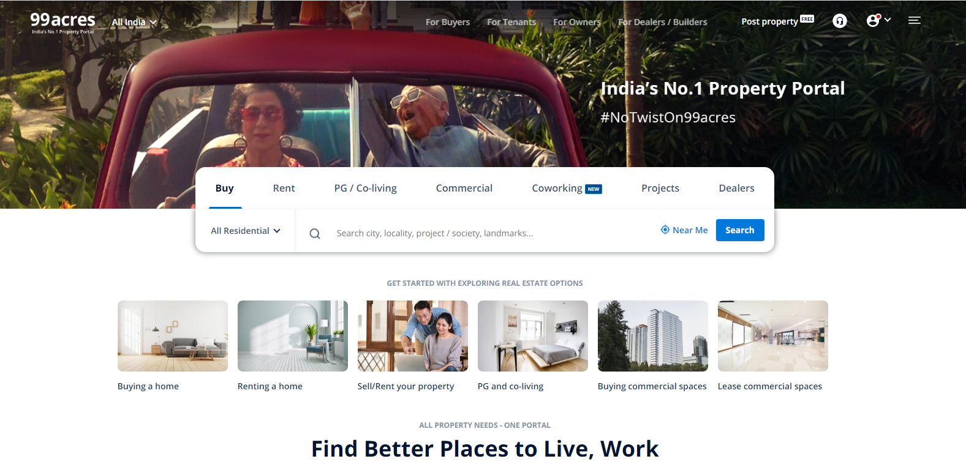
Survey of Existing Systems
www.99acres.com
This website (www.99acres.com) is greatly designed and has a good user interface and is able to show properties to buyers which makes it easier to use this website.
Provides details of the property which makes it easier for buyers to buy properties.
Pros:
Great User interface.
Easy to use.
Cons:
Fewer images about property, making
it difficult for the users to trust them.
a customer's encounter is a lack of reliable information.

Slide 9
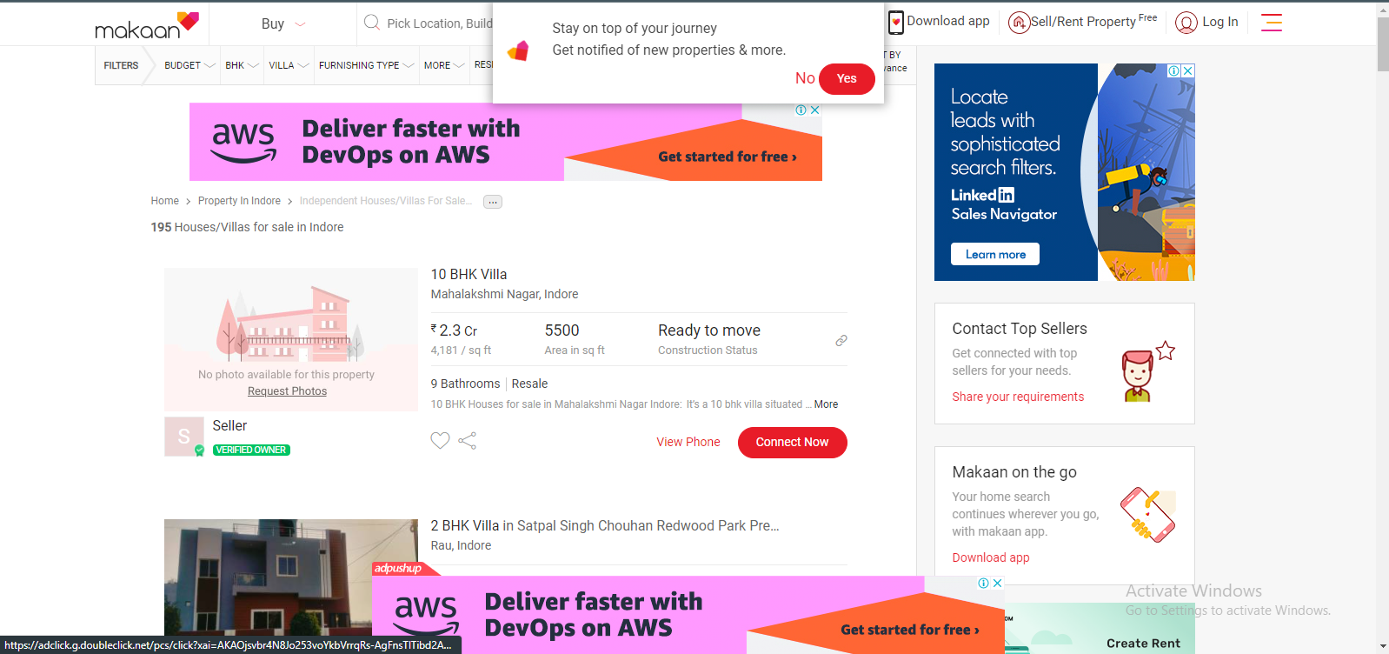
Survey of Existing Systems
www.makan.com
This website (www.makaan.com) is not upto date and has poor user interface and is not able to show properties to users easily due to its poor and difficult user interface.
Pros:
Show details about properties
Cons:
Poor user interface.
Difficult to use.
Too many ads

Slide 10
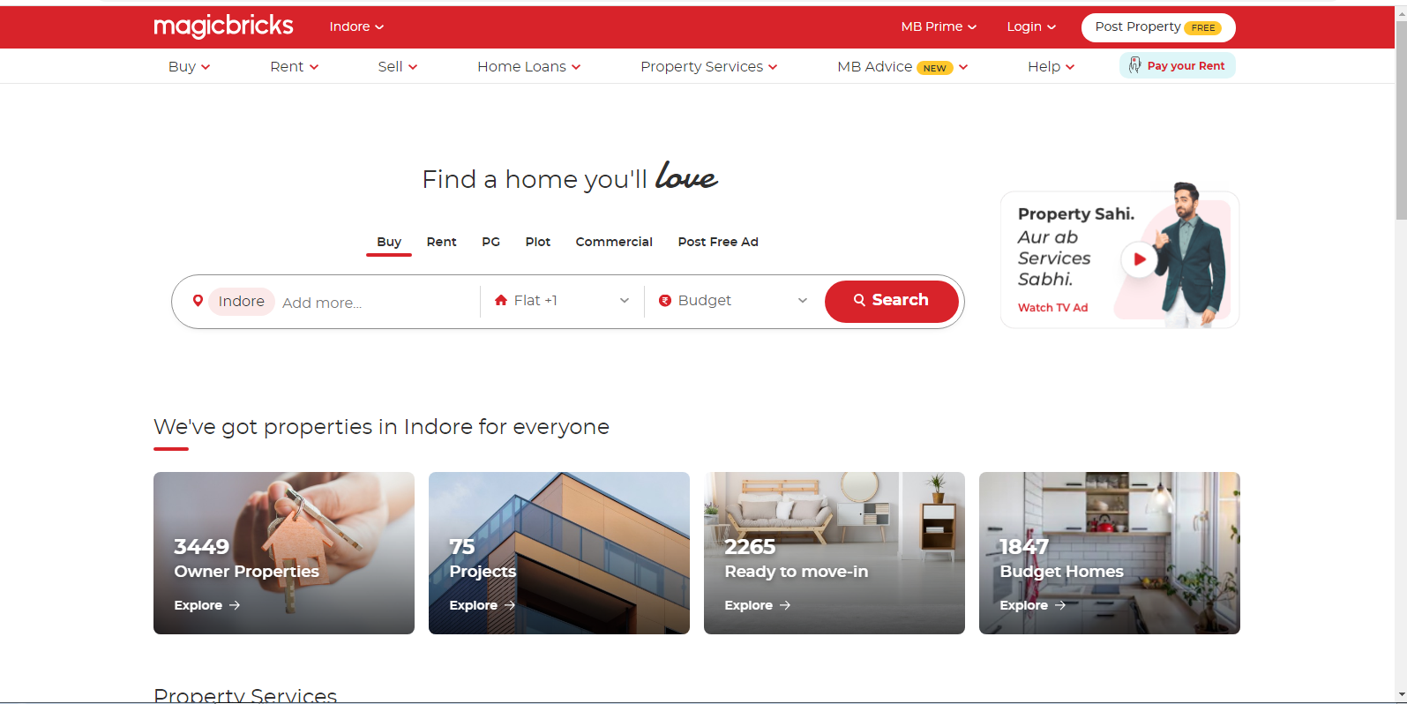
Survey of Existing Systems
www.magicbricks.com
With its unique services and creative online features, (www.magicbricks.com) is an international property site catering to a worldwide market. For the benefit of the customers, Magicbricks real estate portal features are continually being developed, tested, refined, and improved.
At least 75 local and 15 foreign property exhibitions have been held by magicbricks.com since its inception in 2009.
Pros:
Website is very open which makes it easy to find
properties and makes it easy to use the website.
Live video tour guide feature helps buyers in taking
tours of property more easily and efficiently.
Cons:
Customer service is not provided instantly to
buyers and sellers.
Package options for premium members are very limited.

Slide 11
Objectives
To provide powerful logical user management for security
To discuss project planning and the planning process
To list all viewings for property
To display matched property details easily and quickly by one click.
To maintain client details line contact details, required property details, client type like residential and commercial client. Price limit. Preference.
To maintain property details, registration of property for sale includes property address, property description, price, facilities available. Store property floor plan, property documents. Creation of thumbnail of property images for brochure.

Slide 12
Solution Proposed
Issues relative with the well-being of man like shelter and others issues are very important to take decision in the organization. With the help of property management system those issues would be easily tackle.
The proposed system direct communication between owner and purchaser. With these both have and understanding and maintain their directly without any third party mediator
Our Website will be able to aid all who wishes to sell or buy properties and simplifying the process of buying and selling properties by taking it online.

Slide 13
The Outcome Discussion
Every project is carried out to achieve a set of goals with some conditions keeping in mind that it should be easy to use, feasible and user friendly.
Developing a software to effectively manage real estates.
Implementing it on computer system.
Lowering the time taken to buying of properties.
Easy to maintain properties database.

Slide 14
Conclusion and Limitation
The project is to bring real estate industry online and enabling real estate participants to benefit from the internet. Here user can advertise his property for buying and selling.
Limitations
Need issued licence for building a platform where you can buy or sell property legally.
Need at least 128 kb/sec speed and proper internet connection.
Payment gateway.

Slide 15
Q&A

Slide 16
THANKS

